Slide 1
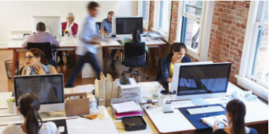
On Open Office Plans
https://hbr.org/2019/11/the-truth-about-open-offices
https://www.cio.com/article/3432536/how-to-make-open-plan-offices-more-productive.html
https://www.mindtools.com/pages/article/open-plan-office.htm

Slide 2
6-Person Cubicle With 2-Sided Desks
7 foot foot wall
Chair
Chair
Chair
~4.5 foot wall
Introvert side
Swivel Monitor
Swivel Monitor
Swivel Monitor
Collab side, no headphones
Example day:
Morning – 11am: everyone on introvert side
  Respond to e-mails, read, think, external calls
11am - lunch: everyone on collab side
  Chat with team, meet informally
Post lunch – 4pm: everyone on introvert side
  Respond to e-mails, read, think
4pm until departure: everyone on collab side
  Chat with team, meet informally
Chair
Chair
Chair
Chair
Chair
Chair
Collab side, no headphones
Swivel Monitor
Swivel Monitor
Swivel Monitor
Introvert side
Chair
Chair
Chair

